Slide 1


SOC-CEM Transformation
January 2020

Slide 2


Agenda
Introduction & Context
Solution Approach
Proposed Teams Plan
Deployment Plan
Solution Details - SOC
Solution Details - Data Lake
Solution Details – Probes
References

Slide 3
Agenda
Introduction & Context
Solution Approach
Proposed Teams Plan
Deployment Plan
Solution Details - SOC
Solution Details - Data Lake
Solution Details – Probes
References

Slide 4
*
Introduction & Context
Understanding of a
SOC Solution
INTRODUCTION & CONTEXT
Telefónica wants to evolve its existing SOC, adding new capabilities in order to have a depth knowledge of the Service Quality perceived and Customer Experience for all services provided. We propose a journey from de current Monitoring and Control situation to a Data Driven Operations Model
FROM… monitoring and control
Knowledge of the state of the services offered, providing a QoE score for each service
…TO Data Driven Operations
Assist in problem management, network planning, customer service and marketing campaigns
Customer Centric Approach
Improve resolution times
All the network information in real time in the same platform allows Telefónica to diagnose better and faster and optimice the resolution times
Increased customer satisfaction and experience
Know the status of each client. Obtain great flexibility to be able to adapt to the needs of each moment
Incident reduction
Manage all necessary alarms for monitoring and integration with other systems for
early detection of service failures to avoid future claims by users
Optimization of preventive maintenance
Analytical capabilities that can be integrated with functionalities based on ML and AI to predict future incidents
Knowledge of the root cause
Knowing in which application, geographical area or in which client/s the failure is located brings benefits such as prioritizing incidents in maintenance plans

Slide 5
*
Introduction & Context
Understanding of a
SOC Solution
OUR UNDERSTANDING
SOC Solution is able to identify faults and performance bottlenecks with focus on service quality and to resolve them proactively to ensure the best customer experience avoiding service impact. Our Customer Centric Approach goes from monitoring and control to be full Data Driven Operations
Telefónica´s Requirements
Visualization layer for Monitoring, Troubleshooting and Resolution of Network/Service/Customer incidents/problems.
Visualization
Transformation
KPI calculation & analytics models execution leveraging Telefonica´s existing components.
Storage
Data provided will be stored, processed and analysed in real time
Data Intake
Real time event data processing : 100% of traffic ,100% of Customers, in all interfaces between networks elements.
Control Plane + Others
User Plane
End to end service tracing capability. Users are able to perform a service trace including all the network segments, combining information collected by existing probes and user plane data by the new SOC probes
OSS, Polystar, etc

Slide 6



*
Introduction & Context
Why an everis-
DEVO-Allot Model
what ARE WE GOING TO DO?
Our solution evolves existing high performance Network & Service architecture based in DEVO, adding additional components to expand capabilities and footprint of services supported. Allot Probes will provide user plane data and service and client level.
The solution is really flexible, every layer can be customized and it could be integrated with every available system in the market
Main tasks
Deploy everis assets ( visualization, models & KPIs) on top of the platform
Configuration of transformation layer for KPIs calculation
Develop new Visualization dashboards over Devo and Power BI
Customize Telefonica's specific use cases both for the SQM and CEM layers
e2e project management
Visualization
Transformation
Storage
Perform predictive analytics across the entire network
Global data lake for all the technologies and devices no matter the event format
Monitor 100% of the data at real time with Zero latency
Offer E2E service monitoring and a 360º view regarding customer experience
Perform Root Cause analysis analyzing the raw data
Integrate with external systems: HDM, OMEGA
Data Intake
Control Plane + Others
User Plane
Single and unified infrastructure for data mediation between producers and consumers
User data plane
Traffic management based on subscriber’s identity rather than IP address
Extracts User Information from RADIUS and uses it to include it and enrich xDRs
OSS, Polystar, etc

Slide 7
Introduction & Context
Why an everis-
DEVO-Allot Model
DIFFERENTIAL VALUE
The main benefits of our solution are the following:
Leverage of existing ecosystem based on Devo as Data Lake
Avoid vendor lock-in being a modular solution adaptable to any change required, new integration or component replacement.
Leverage Existing internal knowhow in Telefonica to continue working as usual
Not a big change, avoiding frictions from different areas
Existing Probes and main Architecture doesn’t change
Minimum risks in the Project implementation and Maintenance
Quick Results
Most functionally required available in few months

Slide 8

*
Introduction & Context
Why an everis-
DEVO-Allot Model
why DO WE DO IT?
The partnership between everis – DEVO – allot presents numerous advantages due to we are already working with Telefónica and we have many synergies, deep knowledge and understanding of the solution to be implements
Extensive experience developing and integrating SOC & CEM solutions in Tier 1 Colombia, México, Peru
Deep understanding of Telefonica’s systems
PoC for Telefónica integrating the main components of this solution
Machine Learning, Data & analytics capabilities
Solution bundled with other suppliers
Top world class real-time solution on the market
DEVO Big Data / Analytics is currently ingesting processed traffic data in Telefónica
Analyze full years of historical information (+ 4,7 PB)
Solution Implemented in Telefónica Spain, Germany and Brazil
Allot has an several projects with Telefónica Spain and LATAM, providing traffic analysis, security services, optimization, proxy or NAT
In the frame of “Optimization and Security Project” we find many synergies related to the development of the new nodes already planned
Not only a DPI, but a full network intelligence solution providing visibility, security services, traffic & bandwidth management

Slide 9
Agenda
Introduction & Context
Solution Approach
Proposed Teams Plan
Deployment Plan
Solution Details - SOC
Solution Details - Data Lake
Solution Details – Probes
References

Slide 10
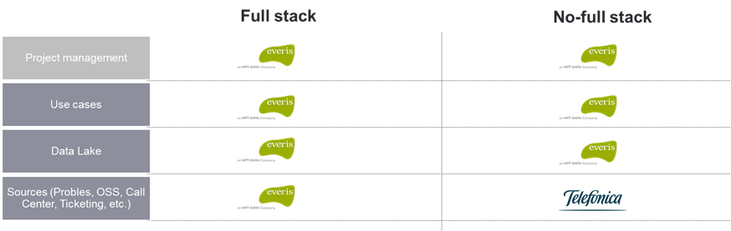
*
Solution Approach
Scenarios
Project SCENARIOS
The solution cover both scenarios Full Stack and No – Full Stack. In our solution, we reuse more than 95% of the data sources required, that are already integrated in Telefonica´s environment
Full Stack
Probe layer with Call Trace & Protocol Analyzer functionalities + functionality and storage needed for SOC/CEM solution
Interfaces via API standard to retrieve data from OSS, Call Center, ticketing, historical BBDD (xDRs and aggregated data), etc..
And full interoperability with vendor OSS systems (E//, Huawei, Nokia)
No-Full Stack
Solution has to integrate Polystar probe system already deployed in Telefonica (probes, Call Trace, Protocol Analyzer)
And Nokia mediator that presently is monitoring exclusively control plane and has not DPI capabilities to monitor user plane
And full interoperability with vendor OSS systems (E//, Huawei, Nokia)

Slide 11
PROJECT MANAGEMENT
CEM & SQM
*
Solution Approach
Functional Scope
PROJECT SCOPE - no full stack
everis proposes a Solution keeping the grey boxes (already deployed in Telefónica) and DEVO as the Big Data / Analytics Platform and adding the yellow ones. everis will develop SQM and CEM functionalities through implementing new dashboards on DEVO and Power BI
Other services
PMO
VISUALIZATION
Dashboards
Alerts
Data Analysis
Vertical App
Power BI
API
Data
Transformation
Visualization
Export / Reporting
Omega/
Astro
Raw / Aggregated data
Transformation / aggregation
Collection
HDM
DATA COLLECTION
Nokia
Mediator
OSS
Nokia, E//
Huawei
Core, NGN,
Femto
CRM, Call center (Genesis, Avaya),
Calls and
Surveys
Ticketing
Breakdowns (IGRI, GRIT )
Inventory System (ATLAS, etc.)
Mediator
Megamon
Megaplexer
5G
Polystar
Probes
DPI Allot
New Solution
Current Solution

Slide 12
Agenda
Introduction & Context
Solution Approach
Proposed Teams Plan
Deployment Plan
Solution Details - SOC
Solution Details - Data Lake
Solution Details – Probes
References

Slide 13
*
Proposed Teams
Proposed Teams
Work Team
The proposed scope includes an experienced team dedicated to guarantee the correct execution off all activities necessary to achieve the goals of this project:
PMO
This Office has the main goal of guaranteeing the correct end-to-end management and execution of the project, coordinating the different teams in order to complete the project on time (follow up the project, detect risks, definition of strategic KPI's, use case customization and initial tool administration etc..). (24 months)
PMO Management
Process assessment
The Process Team is the responsible of As-Is analysis of processes and systems and definition and implementation of the new Operating model (SOC Processes). Document the process related with e-Tom and define the uses cases.
Development of corrective action plans to correct deviations (6 months)
Process & System Consulting
Deployment
Identify the sources of information needed for every service defined to monitor in the SQM and CEM Dashboards and define the interaction with the Probes and Data Lake.
Analyze the data and build the KPIS. Use case definition and customization
Design
Deployment
Launching & stabilization
SQM and CEM Visualization & Reporting
Definition of KPIs and KQIs monitoring and dashboards deployment . Definition of SOC operations and processes to ensure that Customer Experience and Services are properly e2e supervised
Yearly Support
Network and services reporting and Analytics, SLA/Management) + Customer Experience Management, Continual Service Improvement, QoE Reporting
Perform configuration task sin the probes, adapt it to the xDR to the new feed needs in the SOC, software upgrades and infrastructure dimensioning
Office & reporting (O&R)
Technical Office (TO)
Application Maintenance (24x7)
Application Maintenance + Level 3 + Product Support
Change Management
Improve the deployment of the project, propose activities to adapt to the New Operating Model, identify Best Practices
Training sessions dedicated to use cases modification and developments, create a knowledge transfer plan, design reports with PBI. In total, the proposal includes 2 sessions of administration and 15 session of user training
Change management & Training

Slide 14


*
Proposed Teams
Proposed Teams
Work Team
The proposed scope includes an experienced team dedicated to guarantee the correct execution off all activities necessary to achieve the goals of this project:
WORK TEAM
2020
2021
2022
2023
PMO
PMO
PMO
PMO Management
Process assessment
Process assessment
4 FTE’s
Process & System Consulting
Deployment
Probes & Data Lake
Probes & Data Lake
Probes & Data Lake
Design
Deployment
Launching & stabilization
SQM & CEM
SQM & CEM
SQM and CEM Visualization & Reporting
Yearly Support
O&R
O&R
TO
O&R
TO
Office & reporting (O&R)
Technical Office (TO)
AM
AM
AM
AM
Application Maintenance (24x7)
Change Management
CM & Training
CM & Training
Change management & Training

Slide 15
Agenda
Introduction & Context
Solution Approach
Proposed Teams Plan
Deployment Plan
Solution Details - SOC
Solution Details - Data Lake
Solution Details – Probes
References

Slide 16

*
Deployment Plan
Deployment Plan
Timeline of the Project
In the following scenario for the project time line considers that the hardware use will be VDC, so no migration of sources, uses cases and data story will be necessary
2020
2021
2022
2023
PMO
PMO MANAGEMENT
R2
Performance Mobile
R4 – CEM
Mobile Apps v1
1
DEVO PLATFORM IS ALREADY AVAILABLE
Proc.
Asses
Process & System Consulting
R1 –01/10/2020*
Control Plane
R3 – IMS
R5 – Evolution
USER PLANE IS AVAILABLE SINCE H2 2020 for 3 nodes
4
2
Delivery
Inception
Design
Deployment
Visualization
3
FIRST DASHBOARD VISUALIZATION SINCE THE 3-4 month
SQM and CEM Visualization & Reporting
3
5
4
MAIN FUNCTIONALITIES AVAILABLE ON 01/10/2020
Transformation
KPI´s construction
1
5
CONTINUOUS SPRINTS FOR KPIS CALCULATION AND DASHBOARDS
Storage
Integration Data Lake
Support Data Lake DEVO
Data Intake
Polystar Probes & Others
Allot Mobile Probes
Deployment of new probes
2
3 Nodes
6 Nodes
9 Nodes
12 Nodes
Office & Reporting
Yearly Support
Technical Office
Maintenance Service (24x7)
Change Mgmt.
Change Management & Training
* R1 on 01/10/2020 is related to the starting date of the project (January 2020)

Slide 17
Agenda
Introduction & Context
Solution Approach
Proposed Teams Plan
Deployment Plan
Solution Details - SOC
Solution Details - Data Lake
Solution Details – Probes
References

Slide 18
Solution Details
Framework
SOLUTION DETAILS FRAMEWORK (PROBES + DATA LAKE + SOC)
Below is shown the diagram over which we have structured the solution to the SOC transformation
SOC (CEM & SQM)
1
2
3
KPIs/KQIs proposed to measure each of the services
Cases of use defined and/or in operation in other operators that are already using the tool
Flexibility and autonomy on the part of the user to define new KPIs or use cases
SOC-cem-sqm
4
Capacity of disaggregation/segmentation of each of the defined KPIs
5
Machine Learning capabilities
DATA LAKE
6
7
8
Description of
current functionality
Accessibility Of
Data and Expected Historical
Response Time
For Queries
DATA LAKE
9
GDPR: Processing of anonymized customer data
10
11
12
PROBES
PROBES
Description of
current functionality
Solution defined for information processing on encrypted interfaces
(UP + CP)
Evolution: Hardware COTS &
Virtualized Environments

Slide 19
Solution Details
KPIs/KQIs
1
KPIs/KQIs proposed to measure each of the services
We are adding KPI measured from Element Management Systems (EMS) for Mobile PS and CS and defining a first level of priority to determine which visualizations to implement first. This must be reviewed during the first weeks of the project
High
Illustrative
SOC-cem-sqm
DATA LAKE
PROBES
Low
High
EMS: Element Management Systems; PM: Performance Management metrics (counters): CP: Control Plane

Slide 20
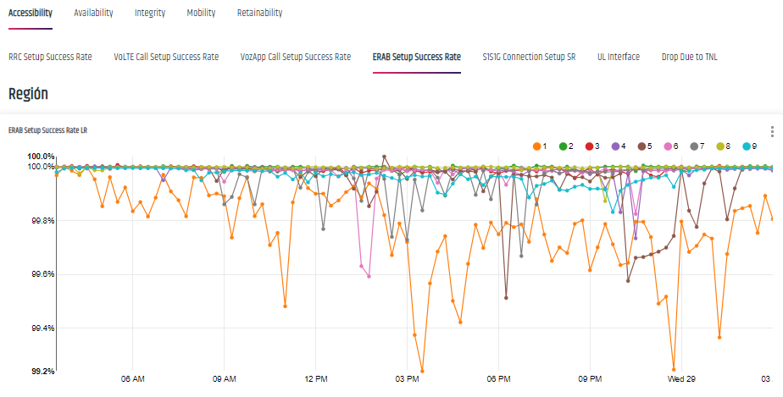
Solution Details
KPIs/KQIs
1
KPIs/KQIs proposed to measure each of the services – pm EMS
This is an example on how to visualize Network Performance data that Telefónica has already enabled
Illustrative
SOC-cem-sqm
DATA LAKE
PROBES

Slide 21
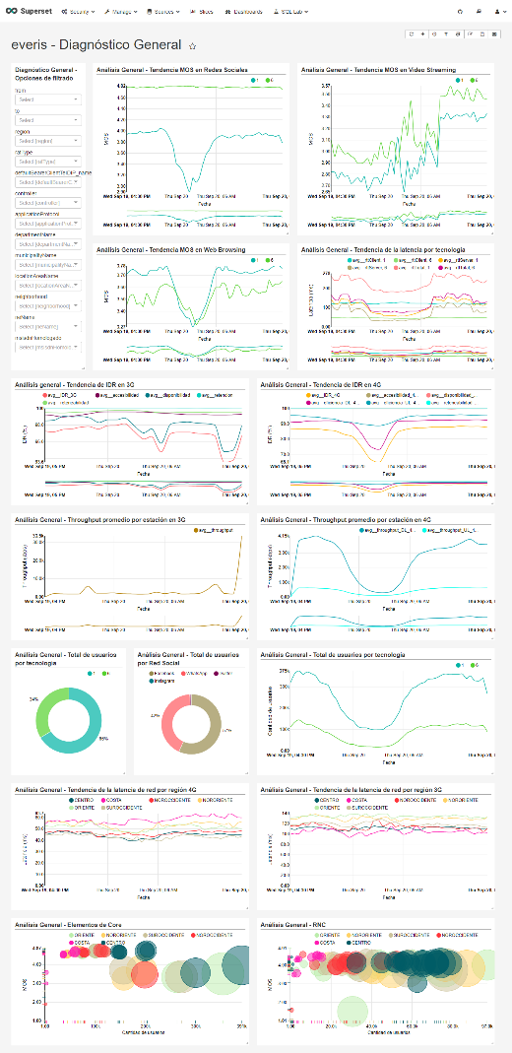
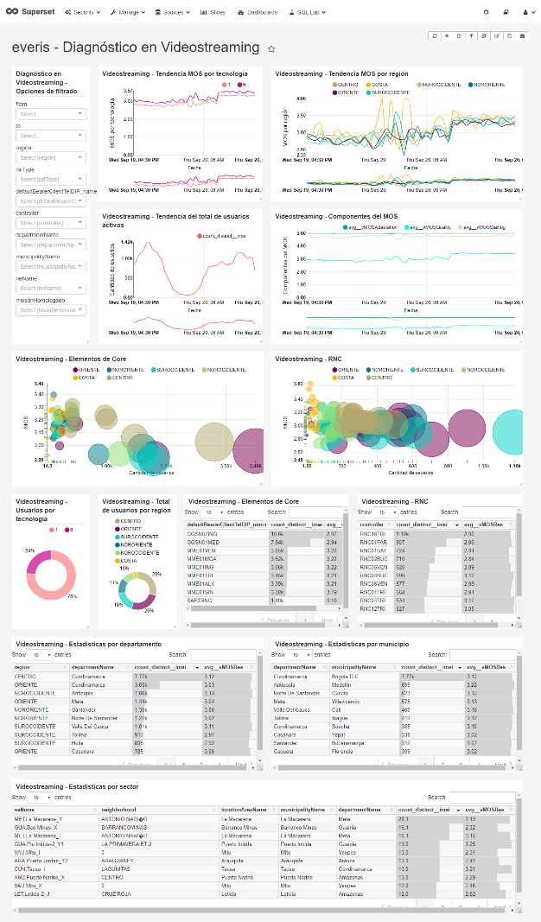
*
Solution Details
KPIs/KQIs
1
KPIs/KQIs proposed to measure each of the services – Latency
In this example, aggregated information can be analyzed and drill-in to the user level to understand Latency measured using data provided by network probes in the mobile network, enriched with geography and topology data.
Illustrative
SOC-cem-sqm
DATA LAKE
PROBES

Slide 22


*
Solution Details
Use Cases
2
USE CASES PROPOSED OVER THE TOP OF THE TOOL
This short list is a result of our experience building successful use cases that have helped customers in their SOC-CEM-SQM processes.
Mobile
Fixed
USE CASE
OBJECTIVE
USE CASE
OBJECTIVE
Mobile user identification tool with controlled quota and no balance
Identify prepaid users with controlled quota and without balance for enrichment of mobile QoE indicators and diagnosis of mobile Internet service degradation reported
Operations tool for monitoring the QoE perceived by users of the home broadband service
Generate QoE indicators (MOS) from the metrics provided by probes in order to identify degradations in web browsing, video streaming, social network and gaming applications.
SOC-cem-sqm
Operations tool for monitoring the performance of the HFC/FTTH access network from the point of view of users
Customer performance index based on metrics measured in the user's modem such as SNR, power, connection status, activity time and packet loss, in order to raise alarms of bad access network performance.
Tool for Mobile Internet Consumer Consultation by User and Application
Provide the users with information about its mobile data consumption habits per application, and integrating billing, controlled quota or no balance information in order to determine if the user has the necessary resources to navigate
Operations Tool for Wi-Fi Network Performance Monitoring
Monitor the status of the Wi-Fi network through a network performance index in order to identify network degradations affecting the quality of the home broadband service
Tool for Mobile network congestion, expansion and failure consultation
Provide information related to congestion, expansions and failures of the network in order to diagnose reported experience problems reported by users
Tool to diagnose the home broadband service per subscription
Provide an end-to-end diagnostic tool of the home broadband service per subscription through integrating indicators of quality of experience (QoE), customer performance index, access network performance, and modem status.
DATA LAKE
Tool for identification of users with GTP lock
Identify in the tool the causes of problems in accessing to mobile services due to PWG blocking
Tool to diagnose Wi-Fi network performance issues
Provide a diagnostic and troubleshooting tool of the Wi-Fi network performance in order to improve the quality of the wireless connection.
PROBES
Tool for billing service degradation diagnosis
Diagnose whether a postpaid user of mobile services are suspended due to billing issues
Tool for diagnosing problems in devices connected to the Wi-Fi network
Provide a tool to identify and solve problems in devices connected to the Wi-Fi network in order to improve the quality of signal received by a device.

Slide 23




Solution Details
Define new KPIs
3
FLEXIBILITY AND AUTONOMY ON THE PART OF THE USER TO DEFINE NEW KPIS OR USE CASES
We are compliant with all the requirements. Raw data is stored, and we are able to build new KPIs ad hoc
KPI
Business Rules (Queries over components)
SOC-cem-sqm
KPI COMPONENTS
Aggregations every X time, + operations / filters over the Counters
DATA LAKE
COUNTERS
(Raw data)
PROBES
PROBES / Sources

Slide 24
Solution Details
Segmentation
4
Capacity of disaggregation/segmentation of each of the defined KPIs
All the aggregated information will be properly correlated and processed according to the specific requirements in terms of indicator provision following these segmentation levels:
Functionalities:
Filters & Segmentation:
Flexibility to customize the formulas to assign different weights about how the individual parameters contribute to the QoE index for each service
The following levels of segmentation are defined. The user will be able to create new levels as required
Network scope - Filtering information based on the topology/network architecture (per GGSN, per SGSN, per RNC, per NodeB, per eNodeB, per MME, per cell, per SBC, per AS)
Network parameters - Filtering information based on different zones (RNCs, Depts., Cities, Zones, Clusters, Cell group, RAN Sharing agreement)
GIS Scope - Filtering information based on geographic information
Segmentation by device - Filtering information based on the different categories of the elements (handset/dongle/tablet, models, manufacturers, Operating Systems)
Network technology - Filtering information based on radio access network technologies (2G/3G/4G/5G/IMS/ Fixed-PSTN)
Customer segmentation - Filtering information based on a predefined customer segmentation (VIP, enterprise and mass users, roaming users)
Application and Protocol Segmentation - Filtering information based on applications and protocols
Regulatory Segmentation - in case of specific regulatory segmentation requirements (Geo-population and Geo-economics) URL Segmentation - Filtering information based on generic and specific URLS including slash
URL segmentation – Filtering information about URLs (generics and specifics) each URL will be computed according to its content
SOC-cem-sqm
Solution shall be able to provide TOP/BOTTON (10/20/50/100) functionalities for whatever segmentation
Multiple/aggregated segmentation functionality. Information shall be handled in terms of analysis, classification and aggregation following multi-dimensional approach
DATA LAKE
The solution shall be able to configure different Customer Groups based on different grouping variables (economical, Services-type, business segments, etc..).
The Raw Data is available and you can build these new segmentations online and maximum drill down capabilities
PROBES

Slide 25
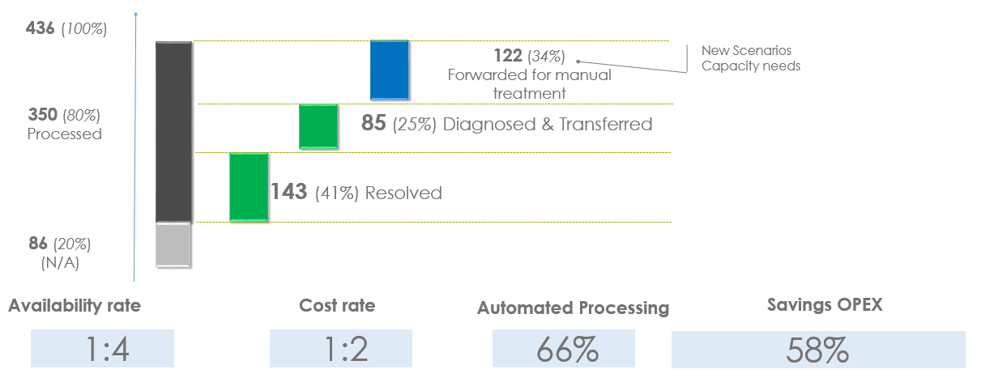
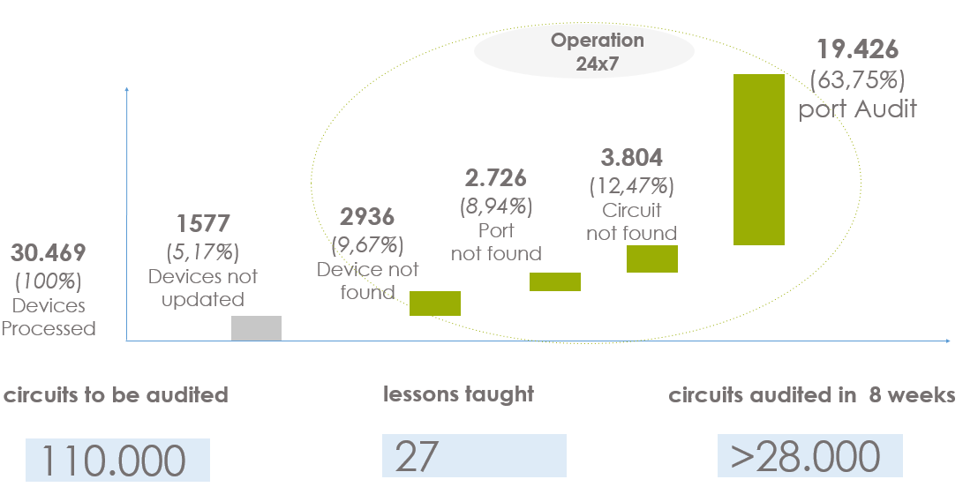
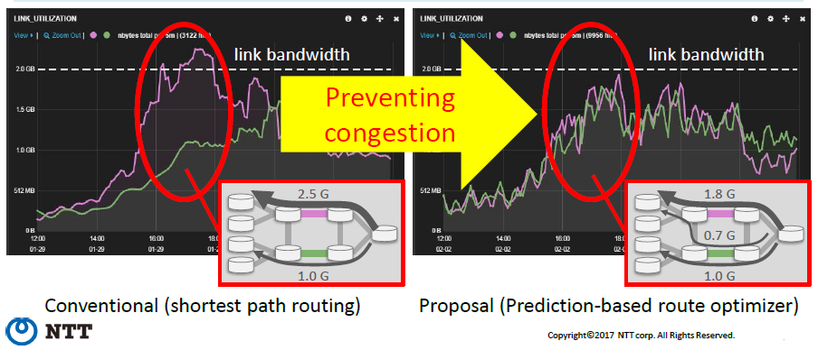
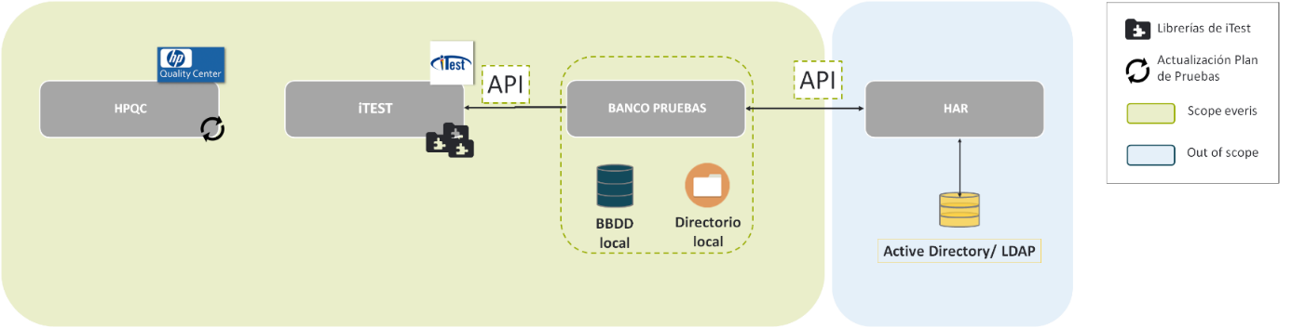
Solution Details
Machine Learning
5
Machine Learning capabilities
everis has machine learning capabilities that can be applied in the project that are complementary to the capabilities of DEVO and Allot
NETWORK capabilities
SOC-cem-sqm
Digitalizing Monitoring
Supervision in NOC/SOC
Automated Network Testing
Advanced Network Analytics
DATA LAKE
Automation of the monitoring, diagnosis and resolutions of repetitive tasks using RPA Technology freeing the worker to focus on more impactful work
Automation of the inventory audit process avoiding manual tasks and improving in data quality
Automation of the execution of the functional tests contemplated in each of the banks
Detection and analysis of potential risks and the application of automatic restoration techniques
PROBES
Using RPA and AI to achieve considerable improvements in automation levels

Slide 26

Solution Details
Machine Learning
5
Machine Learning capabilities
everis has machine learning capabilities that can be applied in the project that are complementary to the capabilities of DEVO and Allot
OTHER ANALYTICS & AI capabilities
SOC-cem-sqm
Cyber Security Insider
Thread protection
e2e Data Processing Platform for Telco
Data Lake usage optimization
In order to identify “anomaly cases” through user logs analysis to detect insider thread risks: malicious insider / negligent insider / credential thief
Airbus has defined a new indicator "Key Trust Indicator" (KTI) as the combinatorial analysis of the algorithms for each user. Users with extreme KTI will be subject to further analysis via the Security Operations Center.
We developed the AI architecture on AWS, implemented algorithms (UBA : user behavior-based algorithm or CBA : community behavior based algorithm), enriched “anomaly cases” learning from historical security breaches and calculating trust level per user.
Technologies : Python, SPLUNK, NEO4J, AWS suite
In order to design a new model of government that allows balancing resources and optimizing consumption
From the historical information of consumptions it allows to find clustering models of user profiles, and
Based on the typologies of users, inventory consumption patterns.
The result of this modeling should be applied on the new information intake to be able to infer with actions at runtime.
Technologies: eAgle (everis AI asset, python, NEO4J
DATA LAKE
PROBES

Slide 27
Agenda
Introduction & Context
Solution Approach
Proposed Teams Plan
Deployment Plan
Solution Details - SOC
Solution Details - Data Lake
Solution Details – Probes
References

Slide 28
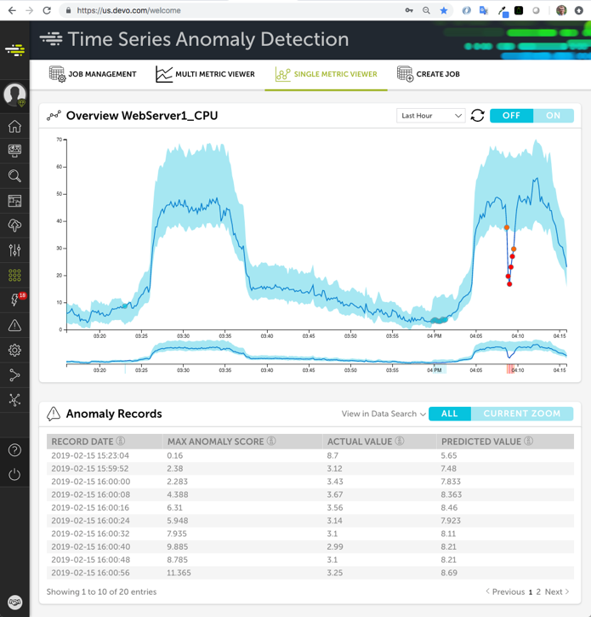
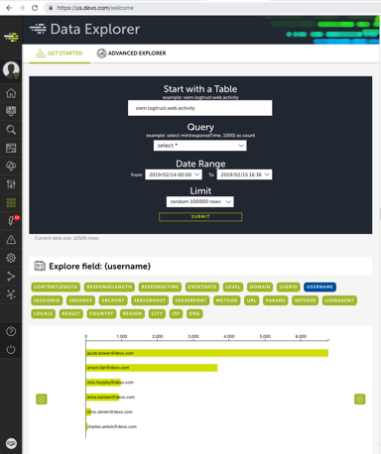
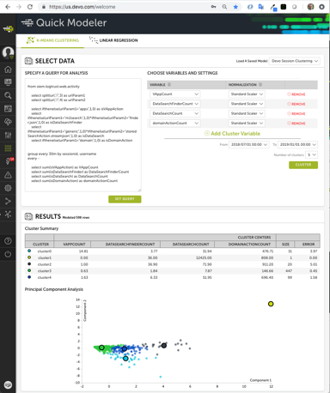
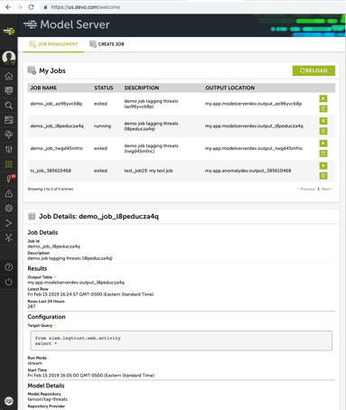
Solution Details
Machine Learning
5
Machine Learning capabilities
Machine Learning: Devo includes Time Series Anomaly Detection, plus forecasting models, to allow the use of dynamic thresholds
SOC-cem-sqm
DATA LAKE
Devo also includes ML capabilities (ML Workbench) to help your data scientist to explore and analyze the data, get training data to create models, and deploy those models in Devo.
Data Explorer
Quick Modeler
Data Science Connector
Model Server
PROBES

Slide 29
Solution Details
Machine Learning
5
Machine Learning capabilities
Machine Learning: Dynamic Thresholds in Alerts tool. Predictive Solution
TOOL
USES CASES
SOC-cem-sqm
Tool able to create and manage customized alerts, based on statistics
Monitor data inactivity in a critical source by checking the reception of some field values (e.g. when a host stops sending events)
Compare current results with several previous related periods (e.g. current last hour results with the same period last 5 Mondays) based on average and standard deviations.
Calculations of statistics data for further analysis and predictions.
Detect a new field value in a table, i.e new user or new host
Alert when no data are received during a period in a table and a grouping key
Alert when having a new value in a grouping key
Alert when grouping key value is lower or higher than a fixed threshold
Alert when grouping key value is lower or higher than a dynamic threshold
Data with statistical info showing trends
DATA LAKE
PROBES

Slide 30
*
Solution Details
Data Lake
Functionality
6
DESCRIPTION OF CURRENT FUNCTIONALITY
Devo provides a Global data lake for all the technologies and devices no matter the event format. This allows E2E service monitoring using data from all “actors” involved in the service delivery and a 360º view regarding customer experience using data from all the processes involved real time supervision
No-compromise architecture
Main differentiators
SOC-cem-sqm
Unify 100% of MACHINE data
ALWAYS 100% HOT
ZERO LATENCY
DATA LAKE
10s of TBs per day
10x smaller footprint
One data set, many uses
Cloud-Scale & MULTITENANCY
Add new data sources, at will
Workloads of the future (humans and algorithms)
PROBES

Slide 31






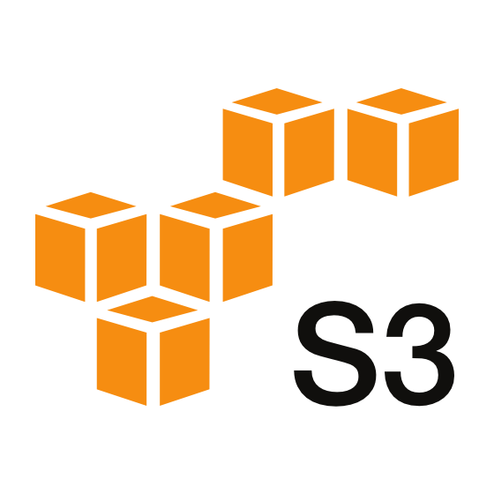

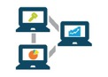
Solution Details
Accessibility
and Historical
7
Accessibility Of Data and Expected Historical
Users and other applications can access directly the data through Devo, from the original raw data to aggregates and ML model outputs
Unlimited users
Easy to use interface
Access to original data, parsed data, aggregation, etc...
Capacity to apply multiples schemes to the same original data
Original events always preserved
Continuous queries
Alarms can be sent as query results
Query sent directly to Kafka, hdfs, S3
All data hot, no difference between historic and real time
SQM & C E M
SOC-cem-sqm
AI Model outputs, anomalies
Aggregates
DATA LAKE
Data with schema applied (multiples)
Raw data in original format
PROBES
Historic → Real Time
Other Apps & Systems

Slide 32
Solution Details
Response time
8
QUERY RESPONSE TIME AND DELAY TIME
Events are made available for real-time analysis instantaneously once served to the Collection engine. Late events are automatically handled by Devo in a way that is seamless for the final user.
Real time events (Push)
Event Generation
Relay (push)
Network
Collection engine
Data Available
Aggregation
Aggregated data Available
SOC-cem-sqm
Event generation and sending to relay + Network Latency
Less than 1 second
Aggregation Period
Batch events (Pull)
DATA LAKE
Event Generation
Relay (pull)
Network
Collection engine
Data Available
Aggregation
Aggregated data Available
Event generation period + event collection time + Network Latency
Less than 1 second
Aggregation Period
PROBES

Slide 33

Solution Details
GDPR
9
GDPR: PROCESSING OF ANONYMIZED CUSTOMER DATA
Devo and the General Data Protection Regulation (GDPR). Devo complies with GDPR and provides its customers with a GDPR-compliant Data Operations Platform.
Key aspects of Devo compliance with GDPR
SOC-cem-sqm
Devo acts as a data processor under the terms of the GDPR
Devo is data-agnostic, providing a mechanism through which the customer determines the purpose and the scope for which it uses the Devo platform and analyzes its own data. Data is only stored in accordance with the customer’s specifications
Devo provides functionality to locate and delete specific records stored in their accounts, searching through the data stored in an account for specific information and to then delete or anonymize such data
Powerful reporting tools enable customers to easily demonstrate compliance with GDPR and other regulations and policies. It also simplifies the process of reporting on compliance
Users can define different retention periods for different types of information, facilitating compliance with many laws and regulations at the same time.
Devo is fully compliant with the data protection principles of Article 5 GDPR, i.e. lawfulness, fairness and transparency, as well as its obligations regarding purpose limitation and data minimization
SOC 2 Type II certification, Devo has appropriate technical and organizational security mechanisms in place to protect against unauthorized or unlawful processing and against accidental loss, destruction or damage of data
DATA LAKE
PROBES

Slide 34
Solution Details
xx
xx
MME
HSS
RADIUS
POLYSTAR
POLYSTAR
SGW/PGW
x
ALLOT
POLYSTAR
ATTACK
POLYSTAR
ACT. CONTEXT
POLYSTAR
SDR
DELAY 5’
CONVERSATION
+
S’
Q
1th
BR…..
UL / 40
POLYSTAR
CONVERSATION
S’
Q
CONVERSATION

Slide 35
Solution Details
xx
xx
NX
SMP
CM
AAA
DM
FUP
Bypass
PGW
RP
cc
cc
cc
cc
SG-TERA
STB
SFP
SAB
ç
ç
Flex
Network Secure
Flex
SNATUG OPT
Flex

Slide 36
Solution Details
xx
xx
TO = 31/03/2020
APR.
MAY.
JUN.
JUL.
AUG.
SEPT.
OCT.
NOV.
DEC.
B/ ESPAÑA
ALLOT
DPI
B/ TORRAS
ALLOT
DPI
V/ P. GALDÓS
ALLOT
DPI
V/ CARMEN
DPI
M/ NORTE
DPI
M/ DELICIAS
DPI
M/ ALMENDR.
DPI
M/ JAVA
DPI

Slide 37
Solution Details
xx
xx
E9000
2 x 100G
TAP
HLC
PCF
10G
(Radio…)
PCF
UPF
VSMP
TAP
HLC
NPB
FS
100G
SMP
DM
SG-9700

Slide 38
Agenda
Introduction & Context
Solution Approach
Proposed Teams Plan
Deployment Plan
Solution Details - SOC
Solution Details - Data Lake
Solution Details – Probes
References

Slide 39
Solution Details
Probes Current Functionality
10
DESCRIPTION OF CURRENT FUNCTIONALITY
DPI Technology gives operators the ability to analyze data from their network in a packaged and granular way, which allows to know the performance of the network, type of traffic and applications in the network, the behavior of users and enable the calculation of perceived QoE by network users by using all the KPIs available and provided by the probe
Multidimensional vision of the application
Applications: identifies and accurately classifies more applications and protocols, enabling any action to be taken at the same level of granularity
Users: identifies the users generating the traffic e.g., a user playing a tablet and a user watching YouTube videos on an iPhone
Devices: identifies the devices being used – smartphone, tablet – and this device manufacturer. This device information allows you to feed a myriad of usage cases including tethering identification, new device campaigns, device-aware optimization, etc..
Access: that allows the monitoring and control of traffic flows at specific access points in order to maintain network performance
Video: provides unique information about OTT video, enabling to build Quality of Experience parameters using different KPIs extracted from video traffic
The benefits that are obtained with the implementation of DPI are the following:
Granular visibility of all network traffic, including OTT applications
SOC-cem-sqm
Multi-dimensional insight into application, user, device, access, context, video and more
Identification of more than one thousand of applications and sub-applications in all network scenarios (mobile and fixed) in an in-line configuration, or as passive probe by mirroring the traffic
DATA LAKE
Benefits of Allot Solution
Solution certified in Telefonica
Know-how in Telefonica network
PROBES
Fast deployment
Possibility of additional services increasing the solution (security, DDOS, other VAS services,etc.)

Slide 40
Solution Details
Encrypted
Interfaces
11
SOLUTION DEFINED FOR INFORMATION PROCESSING ON ENCRYPTED INTERFACES (UP + CP)
Nowadays, encrypted traffic is one of the most important issues for Telecom operators. The solution shall be able to analyze encrypted traffic and provide QoE indicators that let Telefónica know how the QoE of their Customers is
Quality of Experience
The Solution provides a QoE Score for each service and decompose it into its components. Moreover, we can create and adapt the QoE formulate according to the needs. The SOC will display all service-related KQIs (encrypted and decrypted KQIs) on the same screen
SOC-cem-sqm
Machine Learning
The solution will be able to decode the encrypted streaming traffic based on machine learning algorithms and will have an accuracy above 85%, which means being able to categorize 85% of the encrypted traffic being able to create a service model based on traffic identification
No loss of functionality
Security
In the No-Full Stack solution, the SOC solution will be integrated with Telefonica España's probes to collect both control and user data without loss of functionality, ensuring the decryption of 5G signaling with a >85% success rate
The data will be secure from the moment it is sent to the moment they are checked
Encrypted data in transit
Encrypted data in storage
Authenticated data in transit with cross-encryption authentication with digital certificates
DATA LAKE
PROBES

Slide 41

Solution Details
Virtualized
Environments
12
Evolution: Hardware COTS & Virtualized Environments
Allot solution can be fully virtualized, playing the same role in NFVI
SOC-cem-sqm
Increased deployment agility
Elastic service
delivery
Seamless service integration
Complete compatibility
VIRTUALIZED
ENVIROMENTS
Deploy Allot’s Layer-7 application visibility, policy control, charging, and security services wherever they will be most effective - at customer premises, network edge, cloud data center, or small-scale remote locations
Automatic adaptation of VNFs capacity, performance and functionality to support dynamic service demands.
Accelerate time-to-market by delivering some or all of Allot’s market-leading services from a virtualized service delivery framework that is pre-integrated with your NFV (e.g. Gi-LAN) and vCPE requirements
Allot Virtual Edition is fully compatible with your current Allot deployments and with ETSI NFV architecture, giving you extreme flexibility as you plan expansions and new service projects.
DATA LAKE
PROBES
Certified for Open stack and VMWare
Different sizing according to the necessities
Support to full lifecycle management
Rakuten with Allot full virtual solution running in live
Support in UNICA environment to be certified

Slide 42
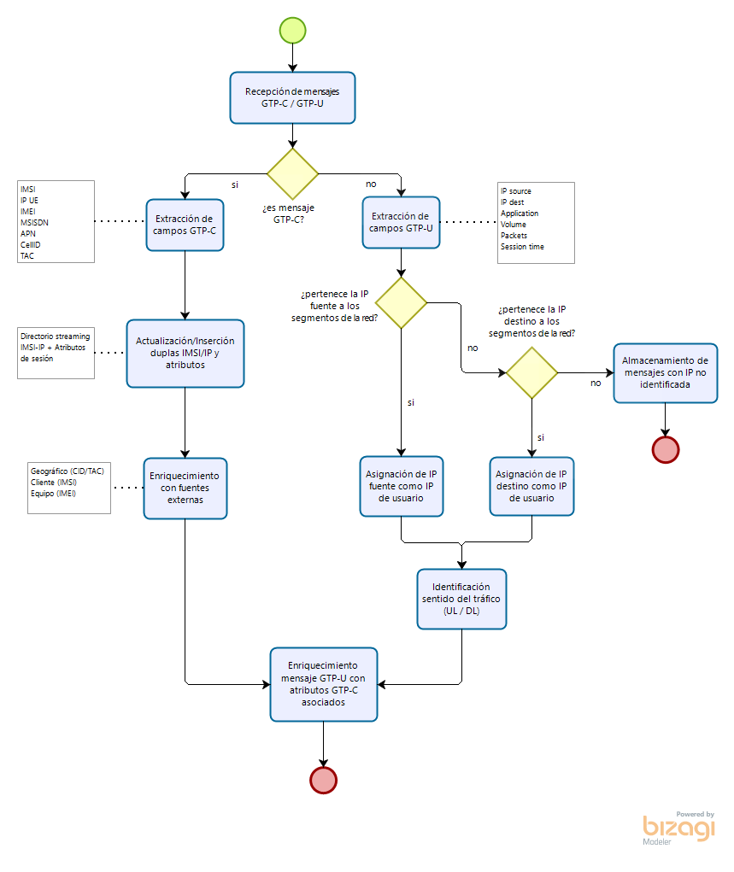
Solution Details
Agenda 20.02.2020
Event correlation between the control plane and the user plane
The process for the event correlation includes stream processing, messaging Queue and data Ingestion
SOC-cem-sqm
Stream Processing
Messaging Queue
DATA LAKE
Data Ingestion
PROBES

Slide 44
Solution Details
Agenda 20.02.2020
Event correlation between the control plane and the user plane
QoE Alarms Generation Process
Indicators Monitoring
No
Atypical Event?
QoE Indicators Streaming
QoE Indicators Aggregation
Anomaly Detection
Anomaly Detection
SOC-cem-sqm
Other Indicators Streaming
Other Indicators Aggregation
YES
No
QoE Deviation > 10%
YES
Duration
>= 6 events/hour
No
Store Atypical Event
YES
Estimate Affected Users
DATA LAKE
QoE Alarms Enrichment
Quantify Alarm Severity
Elaborate SNMP Trap Message
Notify SNMP Trap Message
Visualize SNMP Trap Message
PROBES
Alarms Inspection
Alarms Notification

Slide 45
Solution Details
Agenda 20.02.2020
Event correlation between the control plane and the user plane
QoE Alarms Generation Process
Indicators Monitoring
Alarms Enrichment
QoE Indicators Streaming
QoE Indicators Aggregation
Active QoE Alarm?
No
Discard PM Enrichment
YES
SOC-cem-sqm
PM Counters Streaming
Network KPI Calculation and Aggregation
Same Meas. Hour
No
YES
Last available Network KPI Data
Enrich Alarm Based on QoE Indicator
Estimate Affected Users
DATA LAKE
Elaborate SNMP Trap Message
Notify SNMP Trap Message
Visualize SNMP Trap Message
Alarms Inspection
Alarms Notification
PROBES

Slide 46
Solution Details
Agenda 20.02.2020
Capture of the traffic that does not go through the optimizer
All mobile traffic is captured, while for the fixed network traffic, Allot needs to clarify the architecture and where the nodes for the fixed network can be placed
Mobile traffic traversing the optimizer
What Does: All data plane in (S)Gi
VoLTE and IMS traffic. Infimus percentage (as per data from Telefonica Planning department: about 2Gbps for the whole 12 GGSNs)
VoLTE and IMS traffic can be extracted from Polystar probes
SOC-cem-sqm
Fixed network
To understand which traffic of fixed network wants to be analyzed and the architecture
To understand the amount of traffic that will pass through the probes per node
To understand at which level of aggregation Telefonica wants to include the probes → HL2 can be the most optimal as amount of resources
DATA LAKE
OPTION: as less disruptive solution, DPI can be installed in HL2 nodes, as a separated probe (non in-inline), just getting the traffic mirrored, analyzing and producing xDRs. This way the impact in the network is minimum
PROBES

Slide 47
Solution Details
Agenda 20.02.2020
sampling solution approach
When capturing the information from the user plane, given its exponential growth every year, a solution that allows the filtering of that traffic so that only a part of it is inserted in Devo is required
It is important to Know..
Sampling solution
Details of the proposal to make filtering:
Range of IMSIs
White lists
Sampling of a percentage of traffic
Etc
Part of the infrastructure in which the discarding of unnecessary information takes place
Necessity of additional elements
Impact on the dimensioning by the intake of all or part of the user traffic
From Data mediator: permits to create filtering rules under some logical conditions and some filters (like particular IPs, server IPs, URIs, MSISDN…) so that xDRs are created when the the conditions in the filter are matched.
Each xDR has different conditions to filter
Different profiles can also be created with different filtering policies and rules (conditions, xDRs to be generated, compression, closing time, push properties…)
SOC-cem-sqm
DATA LAKE
PROBES

Slide 48
Solution Details
Agenda 20.02.2020
Dimensioning and planning of deployments
The prices estimate are based on some premises, considering a scenario A in which the 3 current nodes + 3 new ones are installed in the first year and the same in the second year, considering that it takes 6 months to install the first nodes
Considerations:
In 2020 installation of 3 optimization nodes (already contracted) and another 3 by 2021 (not contracted)
Installation of 3 new nodes per year (2020 and 2021), with a total of 12 nodes
The dimensioning of the HW and the calculation of the licenses was made with the Gbps data Telefónica gave us of the estimated traffic for the end of 2020 and 2021
The SW is perpetually licensed (payment once and maintenance the following years), it includes the extraction of all data that the IPR can get
The dimensioning of HW is for the traffic foreseen at the end of 2021
The professional services after the year of installation are a minimum performance per node to update the SW versions ('Major Release' per year)
There are 3 training courses considered for the first year
A Resident engineer is considered since the installation of the first node (6 months in 2020 and 12 months in 2021 onwards)
In the year 2022, there are not HW extensions or licenses, only maintenance, Professional Services and the Resident Engineer
SOC-cem-sqm
DATA LAKE
Notes:
Current node: By reusing the nodes we are already installing from the optimization Project. It will be necesarry to add some additional HW to do the DPI (1 card and 2 data storage servers)
New node: Using the same Service Gateway (SG-Tera) that is in the nodes of the optimization project
Maintenance: 15% HW (5% FLM + 10% HW)
18% SW
PROBES

Slide 49
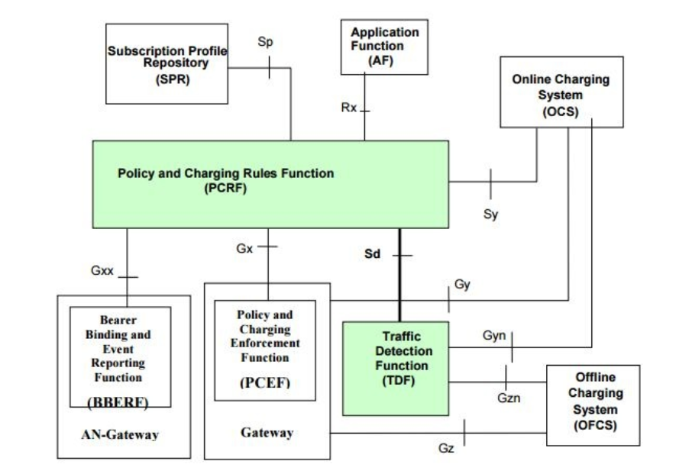
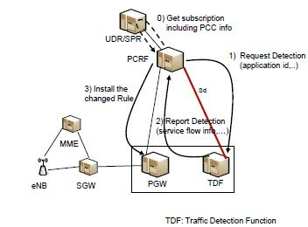
Solution Details
Agenda 20.02.2020
5G monitoring solution
Evolution to 5G: LTE
SOC-cem-sqm
DATA LAKE
PROBES

Slide 50
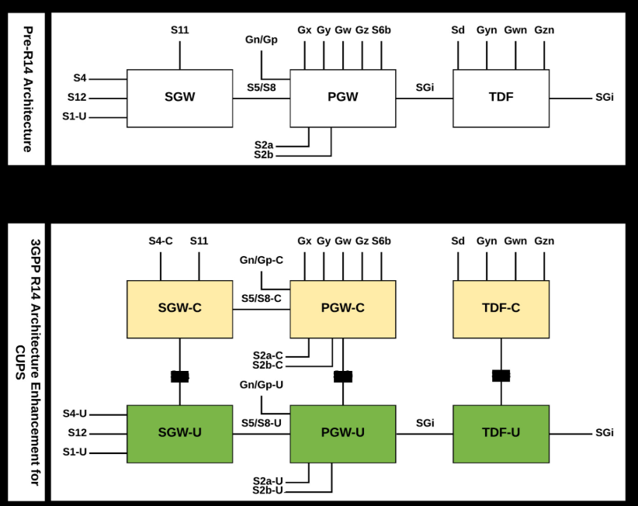
Solution Details
Agenda 20.02.2020
5G monitoring solution
Evolution to 5G: From LTE to NSA (CUPS)
SOC-cem-sqm
DATA LAKE
PROBES

Slide 51
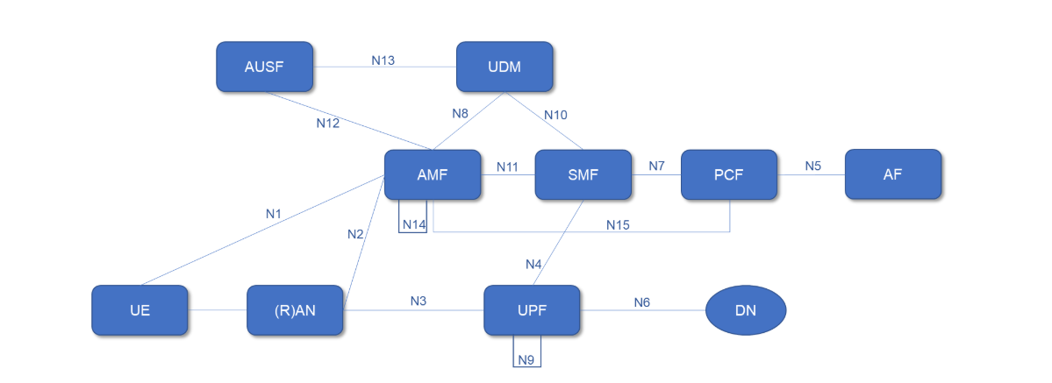
Solution Details
Agenda 20.02.2020
5G monitoring solution
Evolution to 5G: 5GC SA
SOC-cem-sqm
DATA LAKE
PROBES

Slide 52
Agenda
Introduction & Context
Solution Approach
Proposed Teams Plan
Deployment Plan
Solution Details - SOC
Solution Details - Data Lake
Solution Details – Probes
References

Slide 53
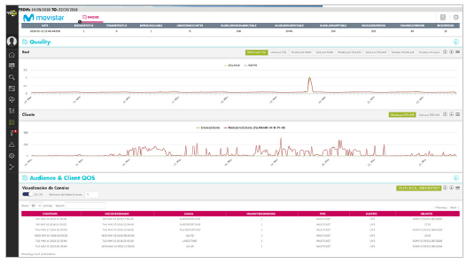
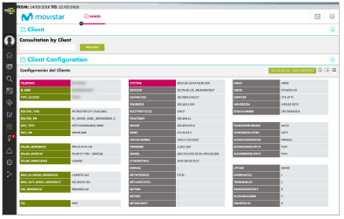
*
References
References
SOC Platform Implementation
Telefónica Spain SOC for IPTV Services
Starting Situation
Telefonica wanted to reduce customer churn and improve the quality of experience of its Movistar+ TV service. The telecom leader needed an end to end platform to measure, track and visualize the quality of service to each customer in real time. DEVO solution was implemented in order to offer the e2e IPTV service vision and monitor customer experience
Objectives
Results
To form a single cloud-based data and analytics platform
To enable a full analysis of all data involved in providing service to each customer
To identify potential problems and new opportunities in the service provided
To have an end to end IPTV service vision and monitor customer experience
Reduced customer churn
Reduced volume of helpdesk calls
Reduced average client call time
Improved customer satisfaction through rapid time-to-insight
Real-time analysis and visualization of large data volumes provides at-a-glance customer insight
Data correlation supports a proactive approach to problem resolutions

Slide 54







*
References
References
Network monitoring implementation and customer experience
Network monitoring implementation and customer experience
Starting Situation
Video Streaming
Quality (HD/SD), Stalling y Quality Variations
Web Browsing Web Page Load Time
Social Networks Retardo E2E (Round-Trip-Time)
Implement the Customer Service Center (CSC) system to monitor the network, services used and customer experience in real time for each specific subscription. It provides customers with real-time access to what is happening in the network and in the services provided to each of their end users
Construction of indicators for time series analysis of Streaming Video, web Browsing and main applications on mobile network enriched with quality indicators and network performance using Streaming Analytics Technology
Objectives
Results
Measure the customer experience by application by exploiting customer data
Calculate the quality of service provided
Assess the state of the network by exploiting data and drill-down on specific geographical areas or network elements
Determine correlation between KQIs/KPIs
Detect the degradation of KPIs/KQIs in real time through algorithms for detecting anomalies and threshold violations
Identify affected users when KPIs/KQIs degradation is detected
Generate alarms to report incidents related to KPIs/KQIs degradation
Take action to improve customer experience through root cause analysis (RCA)
Three quality indicators:
Video Streaming QoE Indicators
Web Browsing QoE Indicator
Social Network QoE Indicator
Analytics: User, Geography and Network topology
KPI’s analysis
QoS vs QoE Root Cause Analysis Tool

Slide 55
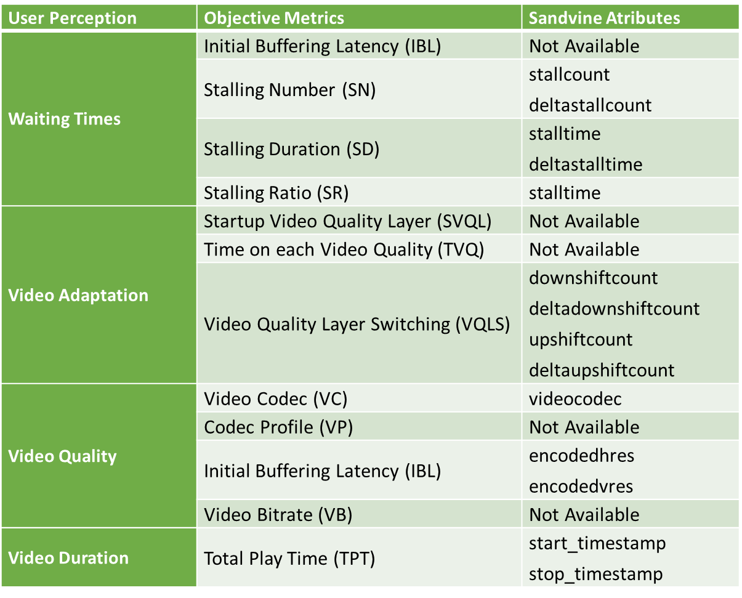
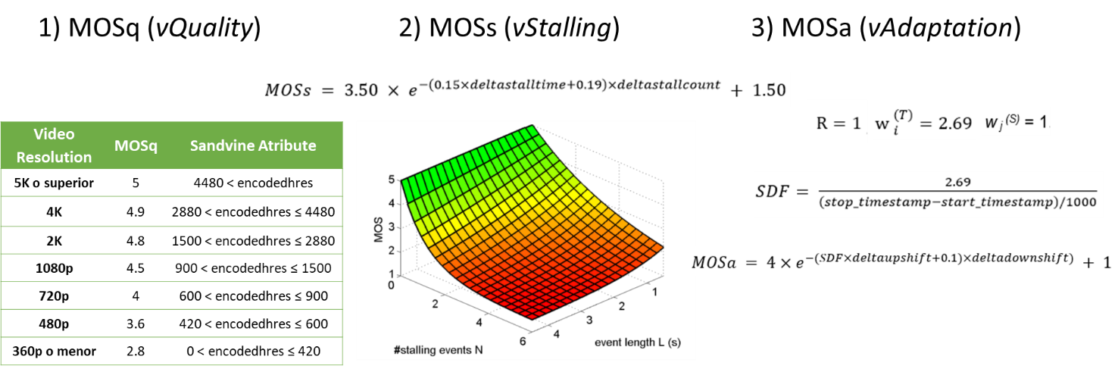
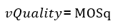
*
Video Streaming
Quality (HD/SD), Stalling y Quality Variations
Web Browsing Web Page Load Time
Social Networks Retardo E2E (Round-Trip-Time)
References
References
Network monitoring implementation and customer experience
Analytics: User, Geography and Network topology
KPI’s analysis
QoS vs QoE Root Cause Analysis Tool
Video Streaming QoE Indicators
Summary
Proposal Model
Factors influencing video QoE
Waiting time, video adaptation, video quality and video duration
Shortcomings of existing target models
Developed for certain types of video (appetitive or progressive)
Some of the influence factors are considerate
Proposal of the indicator for the estimation of the video experience
Video quality (SD, HD, SHD), video interruptions (number and duration) and quality level changes
Hybrid model: adaptive and progressive
Analysis of SDR records of real customers captured with DPI Sandvine
MOS estimate (scales from 1 to 5) to measure experience
Near real-time monitoring of video user experience
Sandvine SVR Map
Results
Definition
Video Experience Indicator Model (MOS video 1.0)
Calculation of the MOS video in SDR records of real customers
Indicator can be applied for progressive and adaptive video
Measure the experience of apps like YouTube and Netflix

Slide 56
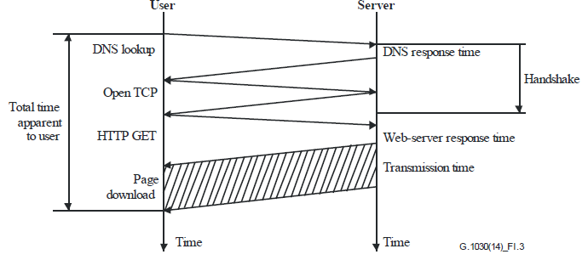
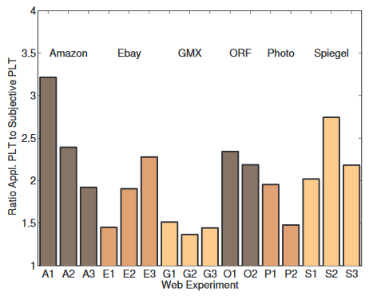
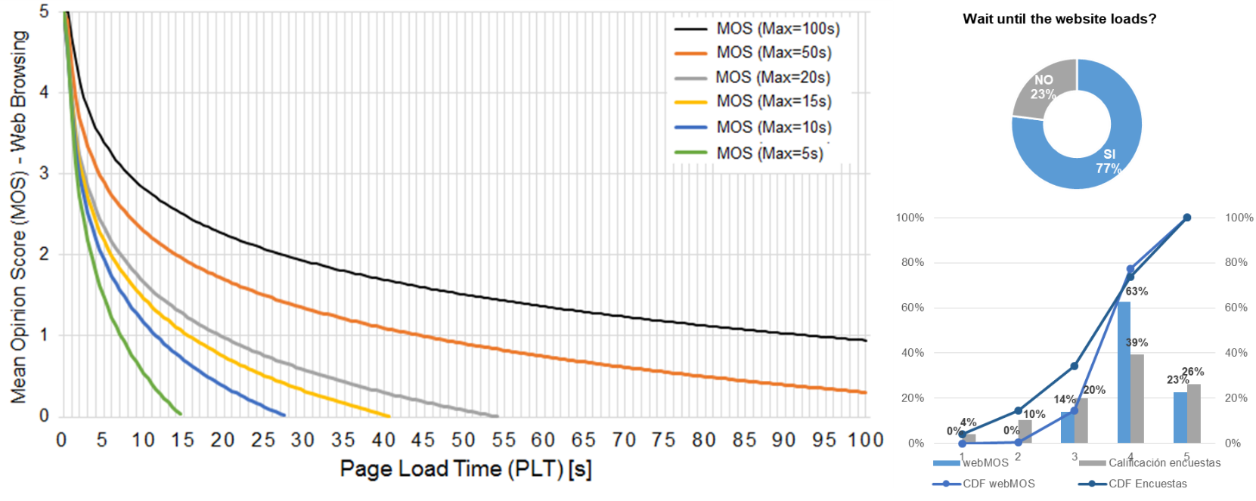
*
Video Streaming
Quality (HD/SD), Stalling y Quality Variations
Web Browsing Web Page Load Time
Social Networks Retardo E2E (Round-Trip-Time)
References
References
Network monitoring implementation and customer experience
Analytics: User, Geography and Network topology
KPI’s analysis
QoS vs QoE Root Cause Analysis Tool
Web Browsing QoE Indicator
Summary
Proposal Model
Technical factors influencing web-QoE (HDR)
Factors influencing web-QoE: Perceived PLT vs. Technical PLT
Web page load time (PLT, Page Load TIME)
Response Time (RT) of the handshake process
Total Download Time (TDT) of the data transfer
Max to the maximum charge time expected to occur in seconds. Its set to 30 seconds
The equation is applicable for PLT between 5 and 100 seconds
Possibility of estimating the maximum time expected for the web pages to be monitored in order to adjust the measurement
Results
Web Browsing Experience Model (MOS web 1.0)
Calculation of the MOS web in HDR records of real customers
KPI can be calculated from any source by the page load time (PLT)
Measures the experience of web Access to the most important and most visited pages

Slide 57
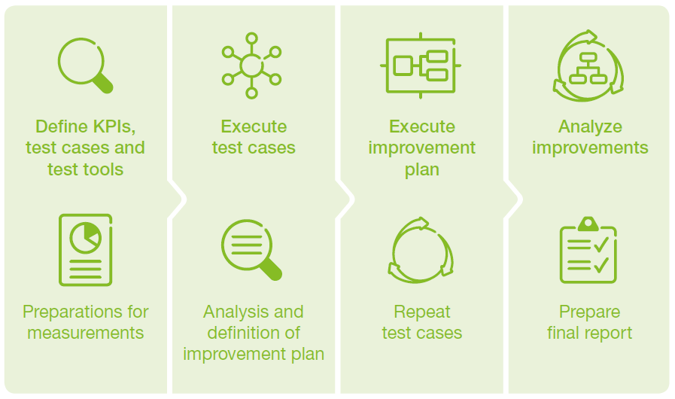
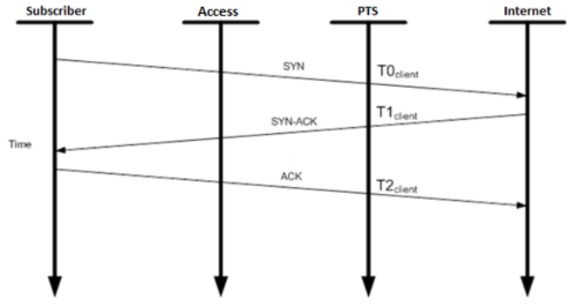
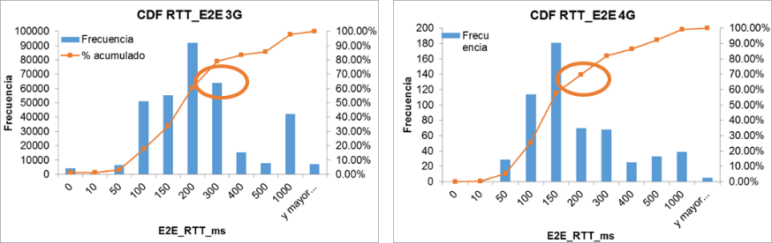
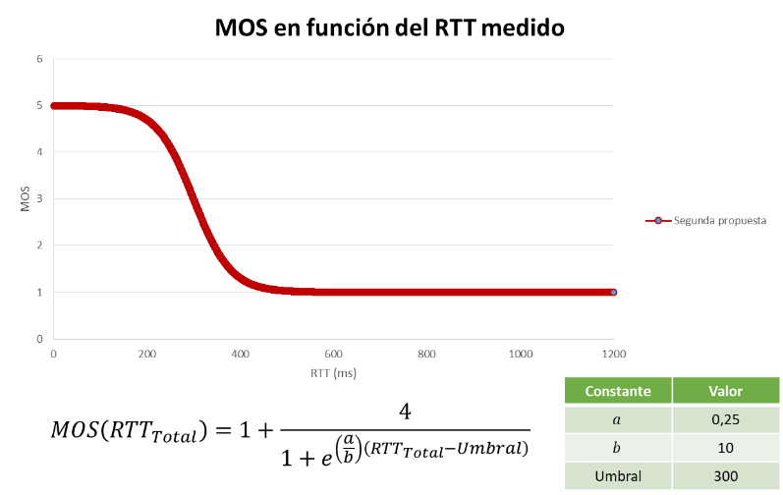
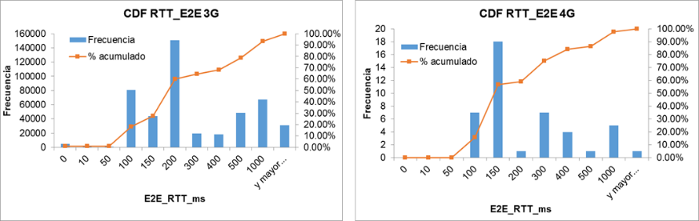
*
Video Streaming
Quality (HD/SD), Stalling y Quality Variations
Web Browsing Web Page Load Time
Social Networks Retardo E2E (Round-Trip-Time)
References
References
Network monitoring implementation and customer experience
Analytics: User, Geography and Network topology
KPI’s analysis
QoS vs QoE Root Cause Analysis Tool
Social Network QoE Indicator
Summary
Proposal Model
Factors influencing video QoE
Factors: user, context and system
Target models based on RTT time (Round Trip Time)
RTT is a metric for estimating packet delay due to network congestion
Measures the integrity of social networking applications
Measure other quality factors such as accessibility and retain ability
Proposal of the indicator for the estimation of the experience of 4 social networks
RTT measurement from HDR files
Model for customers with established PDP session
Analysis of HDR records of real customers captured with DPI Sandvine
MOS estimate (scales from 1 to 5) to measure experience
Near real-time monitoring of the user experience of the socials network
Measuring the QoE of OTT applications using HDR
RTT calculation for OTT applications
Proposed QoE measurement for OTT applications
MOS of Social Networking OTT applications calculation
Results
Experience indicator model for the four social network
Calculation of MOS in HDR records of real customers
KPI can be calculated from any source provided by the Round – Trip time (RTT)
Measures the user experience of Facebook, Twitter, WhatsApp and Instagram applications

Slide 58
*
Video Streaming
Quality (HD/SD), Stalling y Quality Variations
Web Browsing Web Page Load Time
Social Networks Retardo E2E (Round-Trip-Time)
References
References
Network monitoring implementation and customer experience
Analytics: User, Geography and Network topology
KPI’s analysis
QoS vs QoE Root Cause Analysis Tool
QoS vs QoE Root Cause Analysis Tool
Starting Situation
Construction of indicators for time series analysis of Streaming Video, web Browsing and main applications on mobile network enriched with quality indicators and network performance using Streaming Analytics Technology
Objectives
Results
Near real time QoE calculation for main applications from data generated by mobile internet probes
Near real time calculation IDR from data generated by mobile network managers
Enrich data flows with geographic information, network topology and user characteristics (segmentation and plan type)
QoE / IDR Dashboards for monitoring and analysis with drill-down of core network elements, ratio access and geography up to R/Shiny and Python neighborhood
Take advantage of the data generation capabilities provided by internet probes
Storage of processed metrics in low latency Analytical Datastore for real-time and historical queries
Dynamic visualization focused on data self-service

Slide 59


Slide 60

Real-Time Streams
Arquitecture
Arquitecture
The DEVO Platform: Built on a No-Compromise Architecture
Each component of the DEVO Platform is designed to scale linearly enabling enterprises to ingest any amount of data and support massive query loads with significantly fewer resources required and realize a much lower TCO. The scheme below illustrates the general operation of DEVO Platform.
ANY DATA SOURCE, ANY FORMAT, MULTIPLE TBs to PBs PER DAY
CLOUD
CONTAINERS
APP STACKS
INFRASTRUCTURE
SAAS
SECURITY
All data is received by an Event Load Balancer which distributes data to Data Nodes
EVENT LOAD BALANCER
Data Nodes have four primary functions:
Collect and store events completely unmodified to disk
Query the stored data in real-time
Compress the data on average 10:1
Index the data asynchronously
DATA NODE
…
DATA NODE
…
DATA NODE
Collection | Query
Collection | Query
Collection | Query
Meta Nodes distribute query requests to the Data Nodes, assemble the parsed responses, and return the results to the requestor
META NODE
Intelligent Query Distribution Against a Unified Data Set
Devo Relays
TENS OF THOUSANDS OF SIMULTANEOUS QUERIES
Rest API
Web UI

Slide 61
Arquitecture
Arquitecture
The Devo Data Node
The Data Node is designed to ingest and query data as quickly as possible. All processes run independently to meet this goal. Workload management is automatic.
The Indexing Engine asynchronously creates indexes ensuring no contention on ingest. Indexes are not required to deliver real-time responses to queries – they speed up certain queries. These are not traditional indexes.
DATA NODE
The Collection Engine ingests data and writes it to a secured, predefined location. It can handle 10x ingest bursts without dropping an event
INDEXING ENGINE
The Query Engine intelligently utilizes the indexes to query data or performs a full scan of the relevant data set. Either way all searches are performed in real-time.
RAPID ACCESS DATA STORE
COLLECTION ENGINE
QUERY ENGINE
TIME | TENANT | DATA TYPE
The Rapid Access Data Store is an encrypted Linux file system. Data is always hot. All data source types can be queried at the same level of performance no matter the age of the data. Multi-tenancy is enabled by segregating data by tenant.
The Compression Engine asynchronously compresses data each day. Average compression is 10:1 enabling more data to be stored for longer
COMPRESSION ENGINE
ADAPTIVE WORKLOAD MANAGEMENT

Slide 62
Arquitecture
Arquitecture
Allot Probes and DPI
The SOC core solution will be developed in a high availability architecture using both logic and geographical redundancy to ensure hardware and processing systems continuity with minimum service interruption operating in a virtualized environment having its own DCN
Allot Data Flow – System Level counts with 6 steps
5
2
The Data Mediator polls the various data sources (in this case the In-line Platform and the SMP) for the configured data buckets
The RADIUS Server passes the RADIUS accounting message to the SMP
6
The Data Mediator formats the data and sends it on to the Data Warehouse or third-party analytics system
1
RADIUS server performs the AAA functionality for the new subscriber session
4a
Allot Data Flow – Data Mediator
The Data Mediator performs three key functions:
Collects data from in-line platforms
Transforms the data to an output format
Pushes the data to the required targets
The subscriber is granted access to the Internet and subscriber traffic flows through the In-line platform. The In-line platform records the relevant subscriber data (in a series of different data buckets) and…
4b
3
…forwards the subscriber’s traffic to the internet.
The SMP extracts relevant subscriber information from the RADIUS message and passes this on to the In-line Platform. It also generates SDR buckets which aggregate this information on the SMP

Slide 63






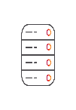

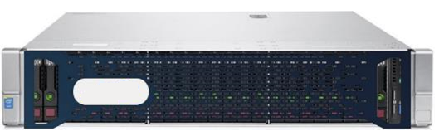

Arquitecture
Arquitecture
Allot Probes and DPI
The SOC core solution will be developed in a high availability architecture using both logic and geographical redundancy to ensure hardware and processing systems continuity with minimum service interruption operating in a virtualized environment having its own DCN
Step 1- The DHCP can be gleaned by Allot SG directly.
Step 2 – The SG passes the DHCP message to the SMP.
Step 3 – The SMP extracts relevant subscriber information from the RADIUS/DHCP/PCRF message and passes this on to Allot Service gateway platform. It also generates CMDR buckets which aggregate this information on the SMP.
Step 4a – The subscriber is granted access to the Internet and subscriber data plane traffic flows online to the Allot Service Gateway probes. The SG platform records the relevant subscriber data plane traffic (in a series of different data buckets) and…
Step 4b – …forwards the subscriber’s traffic to the internet according.
Step 5 – The Data Mediator polls the various data sources (in this case the In-line Platform and the SMP) for the configured data buckets,
Step 6 – The Data Mediator formats the data and sends it on to the Data Warehouse
Step 7 – The DWH sends it or third-party analytics system.
Allot Data Flow – System Level counts with 6 steps
Data Source
Data Mediator
Devo Systems
Telefonica
SMP Server
DM Server
6
7
CEM
CMDR
5
DHCP
3
2
4a
Service Gateway
1
DHCP Traffic
4b
WWW
HDR
VDC
CONV
MOU

